Slide 1
U.S. History
Main Terms & Concepts
What every student should know to pass the U.S. History EOC.

Slide 2
NOTE: On the exam you will be asked to analyze U.S. History using primary & secondary sources. This may include the following:
Interpret primary & secondary sources
Political cartoons
Charts
Graphs
Maps

Slide 3
Links to Main Sections
(Click on the links to move to a Era)
Civil War and Reconstruction
Industrial Revolution
Gilded Age/Populism
Progressive Movement
Imperialism & Spanish American War
World War I
The 1920s
The 1930s & the Great Depression

Slide 4

Civil war & reconstruction
U.S. History
Understand the causes, course & consequences of the Civil War and Reconstruction and its effects on the American people.
Identify the factors and events that led to the Civil War
Describe the course of the Civil War
Understand how Reconstruction effected Americans after the Civil War

Slide 5
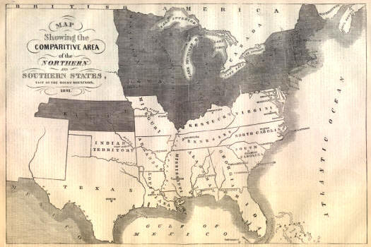
Missouri Compromise, 1820
Admitted Missouri as a slave state and Maine as a free state. Declared that all territory north of 36°30" would become free states, and all territory south of that latitude would become slave states.

Slide 6
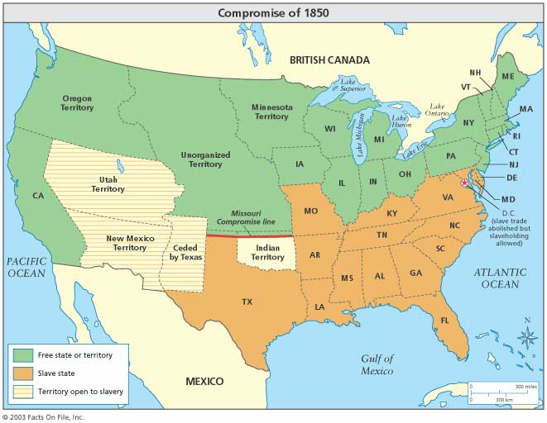
Compromise of 1850
Admitted California as a free state
Organized Utah and N.M. without restrictions on slavery
Adjusted the Texas/N.M. border
Abolished slave trade in D.C.
Established tougher fugitive slave laws.
Its passage was hailed as a solution to the threat of national division.

Slide 7
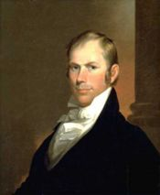
Henry Clay
Clay helped heal the North/South rift by aiding passage of the Compromise of 1850, which served to delay the Civil War.

Slide 8
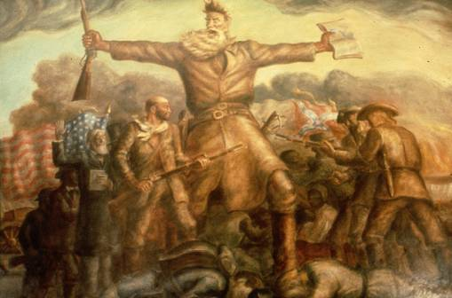
Kansas-Nebraska Act, 1854
This act repealed the Missouri Compromise. Popular sovereignty (vote of the people) would determine whether Kansas and Nebraska would be slave or free states.

Slide 9
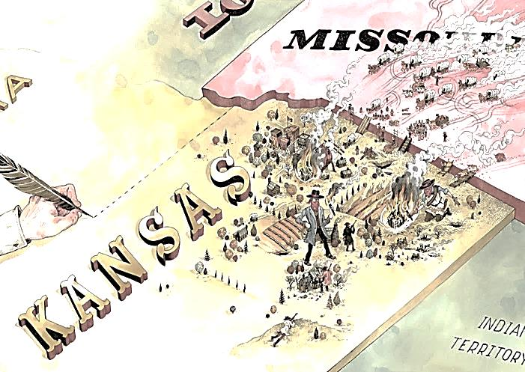
Bleeding Kansas
Name given to the Kansas Territory in the years before the Civil War, when the territory was a battleground between proslavery and anti-slavery forces.

Slide 10
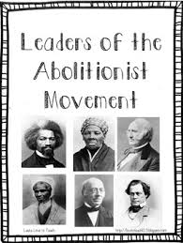
Abolitionist Movement
The movement in America to outlaw slavery which was made up of whites and African –Americans. Its leaders included: Frederick Douglass, Sojourner Truth, John Brown, Harriet Beecher Stowe, and Harriet Tubman.

Slide 11
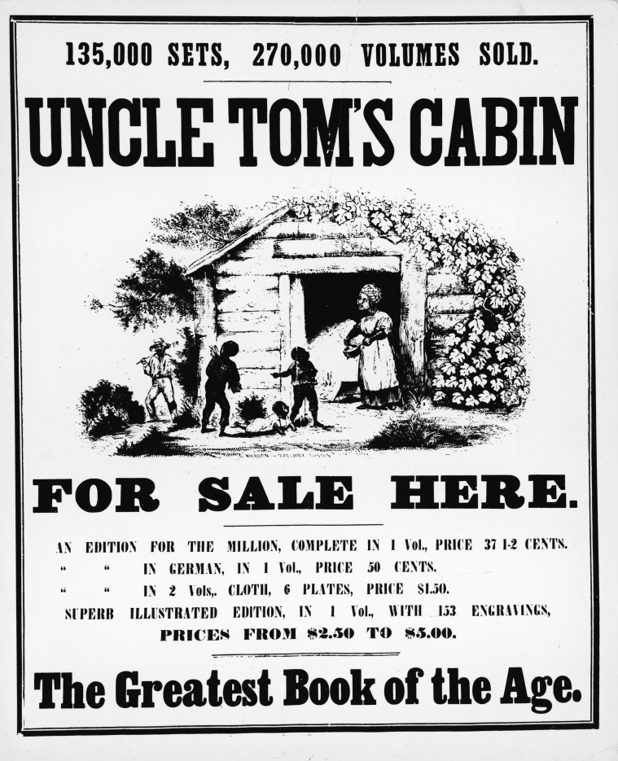
Uncle Tom’s Cabin
A best-selling novel by Harriet Beecher Stowe, published in 1852, that portrayed slavery as a great moral evil and helped to grow the Abolitionist Movement in America.

Slide 12
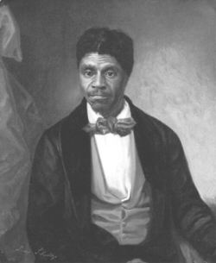
Dred Scott v. Sanford, 1857
A Missouri slave sued for his freedom, claiming that his four year stay in free land had made him a free man. The U.S. Supreme Court decided he could not sue in federal court because he was property, not a citizen.

Slide 13
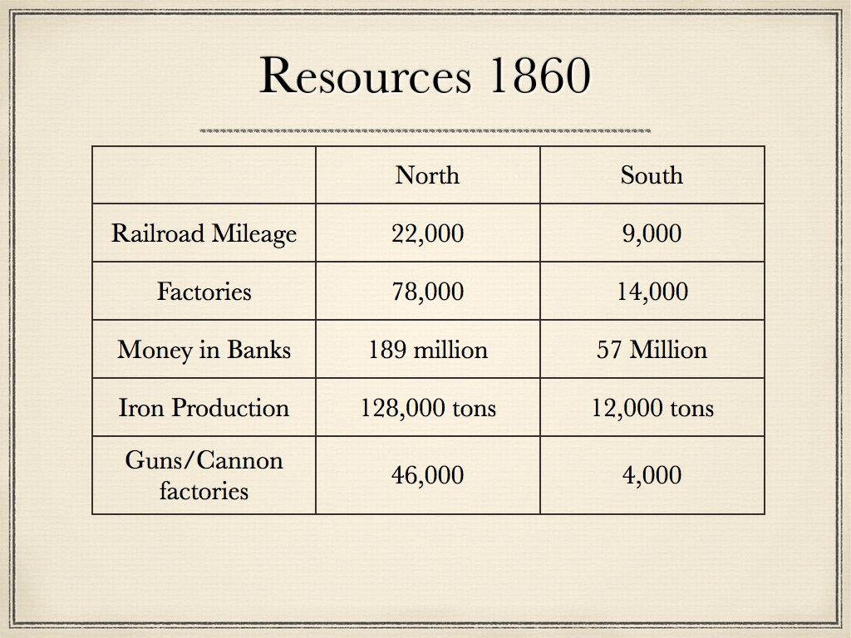
Resources of the North & South
The North:
Factories, Railroad tracks, Telegraph wires,
Labor force.
The South:
Plantations, Slaves,
Cotton, Rivers.

Slide 14
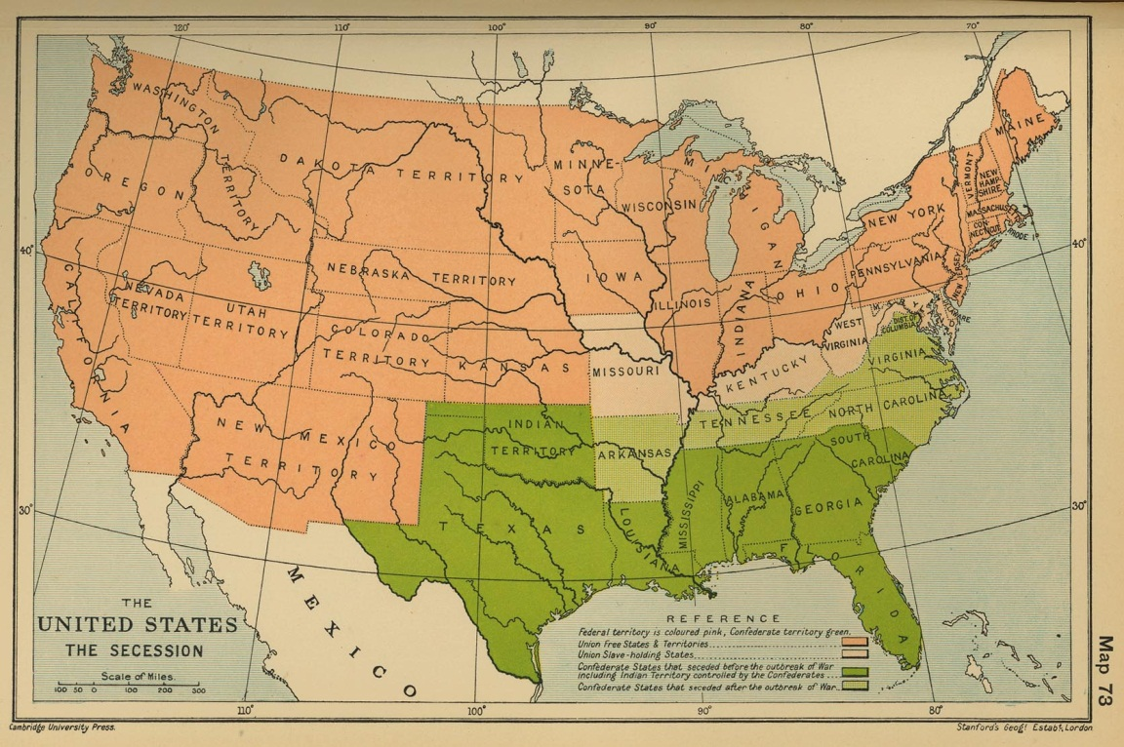
Causes of Secession, 1860
After Lincoln was elected, seven Southern states seceded. They cited as their reason for seceding the election of a President “whose opinions and purposes are hostile to slavery.”

Slide 15
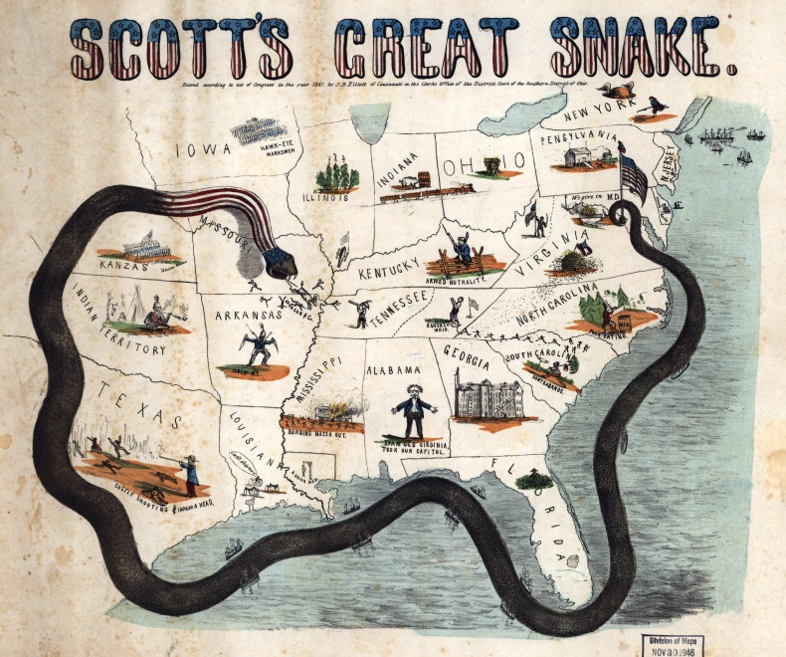
Anaconda Plan
Three part 1862 Union war strategy to defeat the South:
Blockade Southern ports.
Cut the Mississippi River in half.
Capture Richmond.

Slide 16
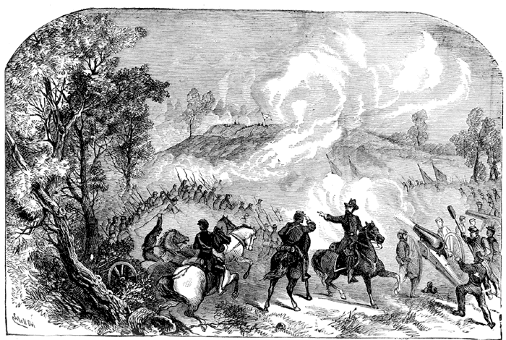
Battle of Gettysburg, 1863
90,000 soldiers under Meade vs. 76,000 under Lee, lasted three days and the North won. Considered a turning point of the Civil War.

Slide 17
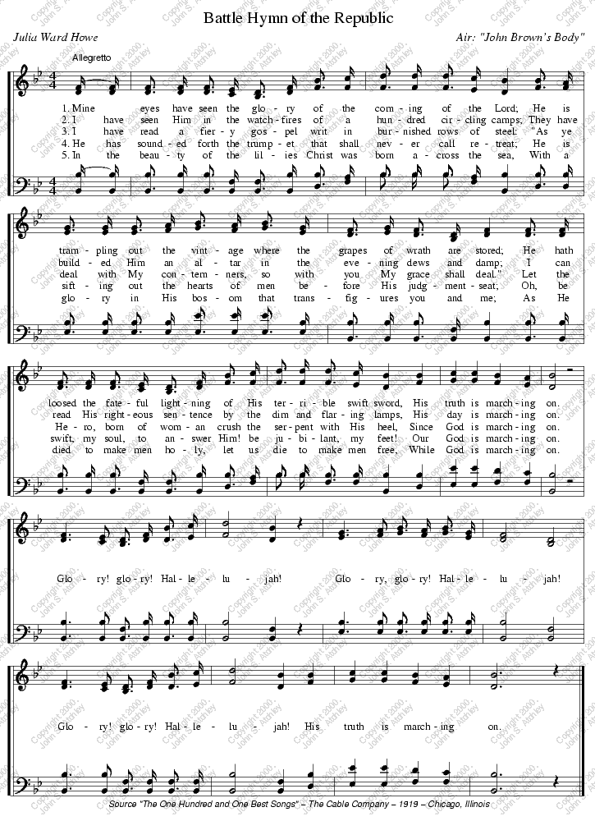
“The Battle Hymn of the Republic”
Abolitionist & poet Julia Ward Howe in 1861 composed these lyrics toward the cause of ending slavery. When Lincoln first heard the song he cried out as tears rolled down his face “sing it again! Sing it again!”

Slide 18
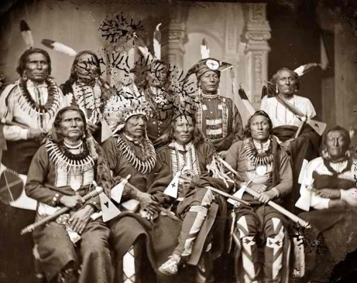
Native Americans in the Civil War
The North & the South both courted Native American tribes during the Civil War. While tribes like the Cheyenne supported the North, the Creeks & Choctaws supported the South.
The Cherokee were
divided within itself
over who to support.

Slide 19
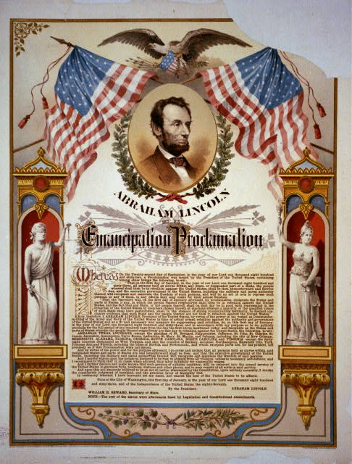
Emancipation Proclamation, 1862
Lincoln freed all slaves in states that had seceded. Lincoln had no power to enforce the law.

Slide 20
Reconstruction Plans
Presidential Plans
Lincoln offered the “Ten Percent Plan.”
Johnson’s plan was similar to Lincoln’s, but required wealthy planters to request pardons and did not support voting rights for African-Americans.
Congressional Plan
“Radical Republicans” passed the Wade-Davis Bill. Lincoln pocket vetoed the bill.
Established Freedmen’s Bureau and passed the Civil Rights Act of 1866.

Slide 21
Civil War Amendments
13th - Freed all slaves, abolished slavery.
14th - It granted full citizenship to all native-born or naturalized Americans, including former slaves and immigrants. No state shall deny a person life, liberty, or property without due process of law.
15th - No one could be denied the right to vote on account of race, color or having been a slave. It was to prevent states from amending their constitutions to deny black suffrage.

Slide 22
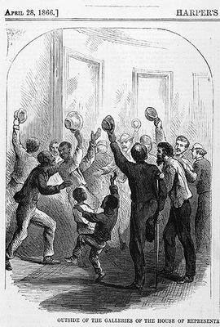
Civil Rights Act of 1866
Prohibited abridgement of rights of blacks or any other citizens.

Slide 23
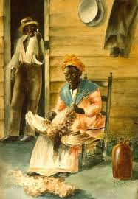
Black Codes
In order to restore the “old” ways Southern states passed these codes that:
1.Limited African-American occupations to that of servants & farm laborers.
2.In some states African-Americans were prohibited from owning land.

Slide 24
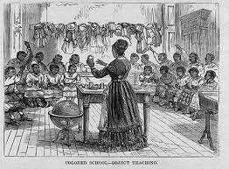
Freedman’s Bureau
Federal government agency established in 1865 to aid nearly 4 million emancipated slaves as they transitioned to freedom.
It provided:
Schools for education
Medical care
Marriage Certificates

Slide 25
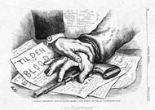
Compromise of 1877
Hayes promised to show concern for Southern interests and end Reconstruction in exchange for the Democrats accepting the fraudulent election results. He took Union troops out of the South.

Slide 26
Industrial Revolution,
Gilded Age,
Populism,
Progressive Movement
U.S. History
Analyze the transformation the American economy & the changing social and political conditions in response to the Industrial Revolution.
Distinguish how the Industrial Revolution of the late 1880s and early 1900s changed America from the perspective of workers and industrialists
Recognize social challenges that occurred during the Industrial Revolution, and responses to these challenges

Slide 27
Industrial Revolution
U.S. History

Slide 28
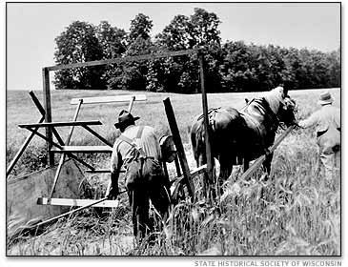
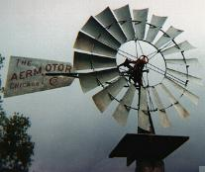
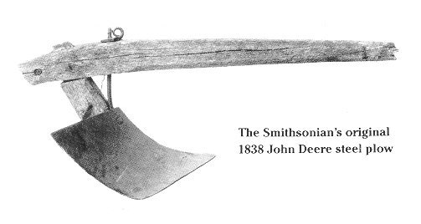
Improvements in Agriculture
Mechanized reaper – reduced labor force
Steel plow – cut through dense sod
Barbed wire – kept cattle off crops
Windmills – powers irrigation systems
Hybridization – allowed greater yields

Slide 29
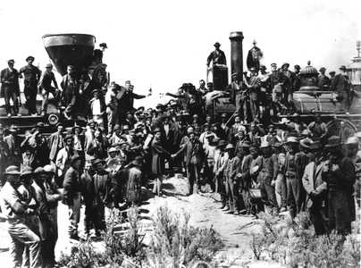
Transcontinental Railroad, 1869
Union Pacific began in Omaha in 1865 and went west. Central Pacific went east from Sacramento and met the Union Pacific Railroad at Promontory Point, Utah.

Slide 30
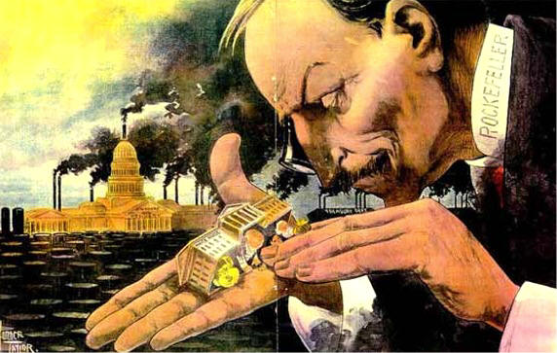
Influence of Big Business
Larger pools of capital
Wider geographic span
Broader range of operations
Revised role of ownership
New methods of management

Slide 31

Laissez-faire
A theory that the economy does better without government intervention in business.

Slide 32
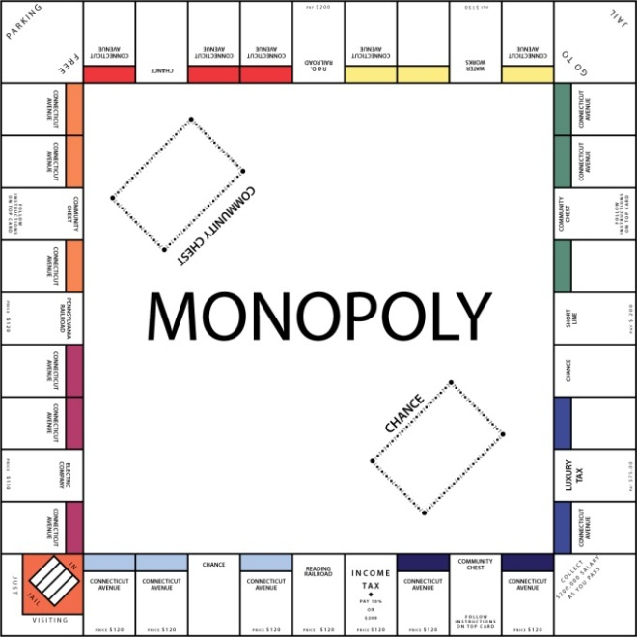
Monopolies
A market structure where a company has been able to either buy out all of its competitors or simply run them out of business. At that point the company has complete control over a product
or service in that area.
Example: Standard Oil

Slide 33
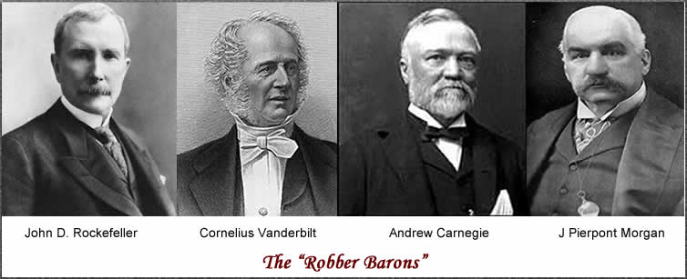
Industrialists
John D. Rockefeller-Oil
Andrew Carnegie- Steel
J.P. Morgan- Banking & finance
Cornelius Vanderbilt- Railroads

Slide 34
Robber Barons
a term applied to a businessman in the 19th century who engaged in unethical and monopolistic practices, wielded widespread political influence, and amassed enormous wealth.

Slide 35
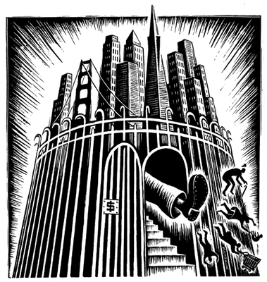
Social Darwinism
Applied Darwin's theory of natural selection and "survival of the fittest" to human society -- the poor are poor because they are not as fit to survive. Used as an argument against social reforms to help the poor.

Slide 36
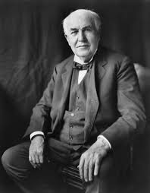
Inventors & Inventions
Alexander Graham Bell- The telephone
Christopher Sholes- The typewriter
Henry Bessemer- Bessemer Steel process
Thomas Alva Edison- He had
over 1,000 inventions including
electricity. (light bulb, fans,
& printing pressess)

Slide 37
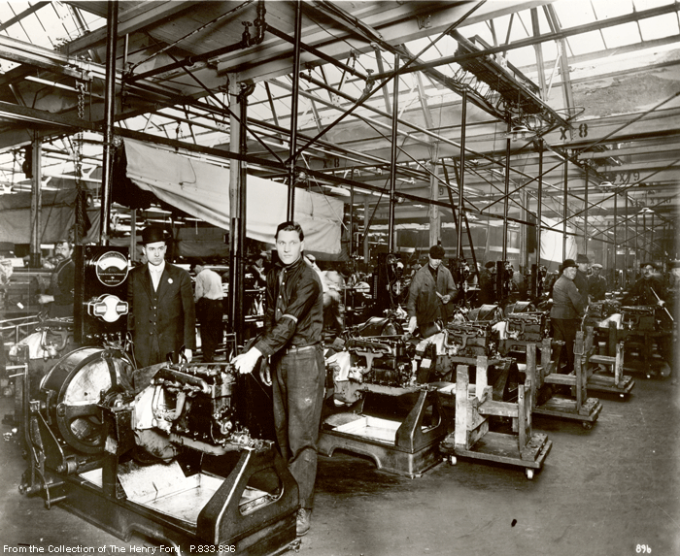
Assembly Line
Arrangement of equipment and workers in which work passes from operation to operation in a direct line until the product is assembled.

Slide 38
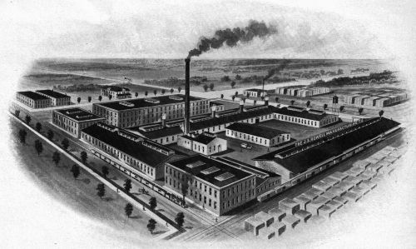
Factory Working Conditions
12 hour days, 6 sometimes 7 days a week
Unsafe, dangerous, dirty, poorly ventilated, poorly lit, faulty equipment
Low wages
No benefits
Children as
young as 5
worked in factory.

Slide 39
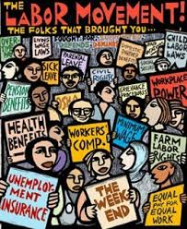
Labor Unions
A labor union is an
association of workers who
join together to promote and
protect the welfare, interest,
and rights of its members by
a process called Collective
Bargaining.

Slide 40
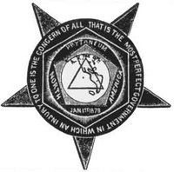
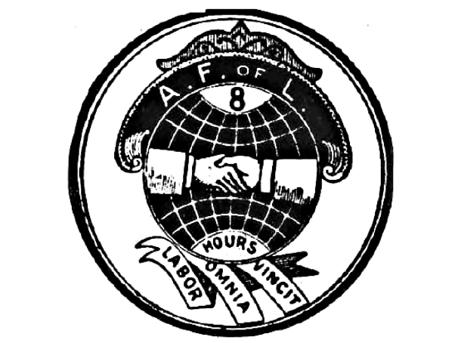
Examples of Labor Unions
Knights of Labor
An American labor union originally established as a secret fraternal order and noted as the first union of all workers. It was founded in 1869.
American Federation of Labor
Began in 1886 with about 140,000 members; by 1917 it had 2.5 million members. It is a federation of different unions.

Slide 41
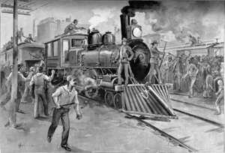
Labor Practices
Collective Bargaining - Discussions held between workers and their employers over wages, hours, and conditions.

Slide 42
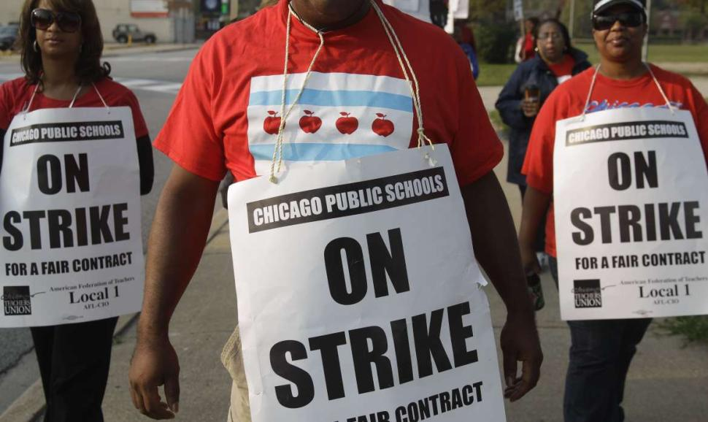
Tactics of Labor - Strike
This is a work stoppage intended to force an employer to respond to workers demands.

Slide 43

Tactics of Labor - Boycott
Here workers encourage citizens to not buy or use a company product until that company gives into the worker’s demands.

Slide 44

Tactics of Management - Lockouts
Here the owners of the factory lock the workers out of the factory building until the workers give in or compromise with the factory owners demands.

Slide 45
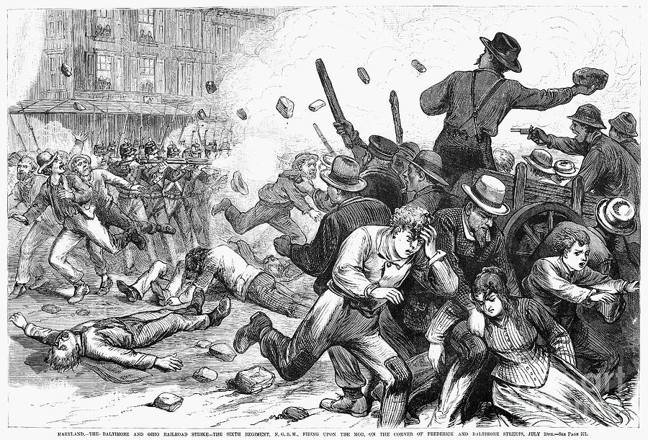
Great Strike 1877
This was a railroad strike over cuts in worker’s wages. This strike set the scene for violent strikes to come.

Slide 46
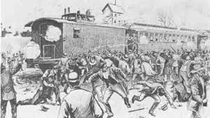
Pullman Strike 1894
Workers of the Pullman rail car company went on strike over wage cuts & layoffs. The strike grew violent. 12,000 federal troops were called in to end the strike.
The factory owners used the federal courts
to limit the power of
the unions. This led
to a decrease in
union membership.

Slide 47

Interstate Commerce Act
A law, enacted by Congress in 1887, which created the (ICC) Interstate Commerce Commission that attempted to supervise and regulate railroad companies and activities.

Slide 48
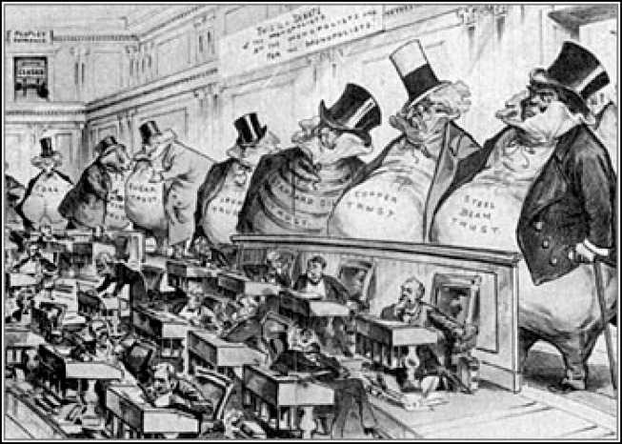
Sherman Anti-trust Act
A law, enacted by Congress in 1890, that was intended to prevent the creation of monopolies by making it illegal to establish trusts that interfered with free trade.

Slide 49
Gilded age and populism
U.S. History

Slide 50
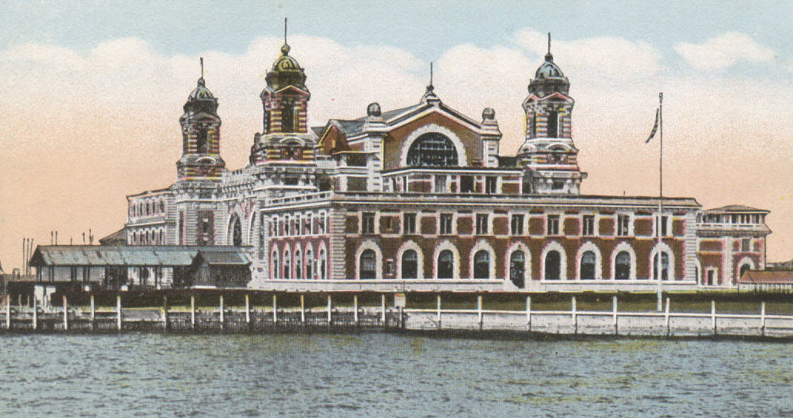
Ellis Island
Located in New York Harbor, it served as
an immigration station for millions of immigrants arriving in the U.S. from Europe between 1892 and 1954.

Slide 51
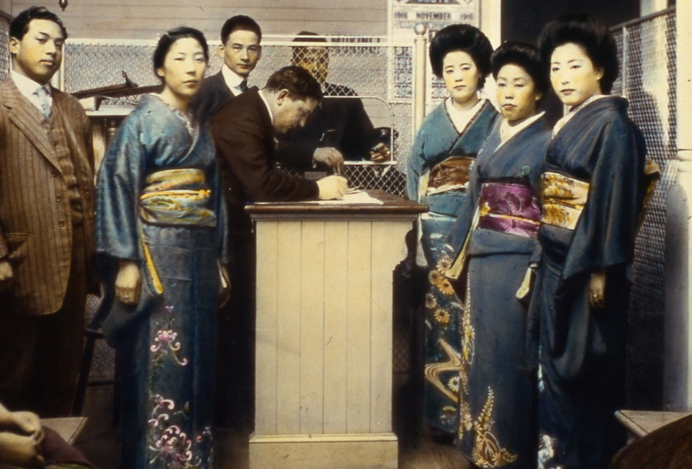
Angel Island
Asians-primarily Chinese, arriving on the U.S. West Coast were processed at this immigration station in San Francisco Bay,
California between
1910 and 1940.

Slide 52
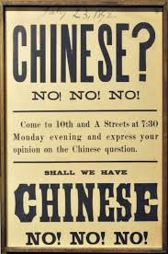
Chinese Exclusion Act
A law, enacted in 1892, that prohibited
All Chinese except students,
teachers, merchants, tourists,
and government officials from
entering the U.S. The law was
not repealed until 1943.

Slide 53
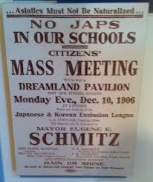
Gentlemen’s Agreement
In San Francisco the Board of Education in 1906 took all Asian school children and placed them special Asian Schools. As a result Anti-American riots broke out in Japan. In 1907-1908 an agreement was reached in which
Japan agreed to limit Japanese
emigration to the U.S. and in return
San Francisco withdrew its
segregation orders.

Slide 54
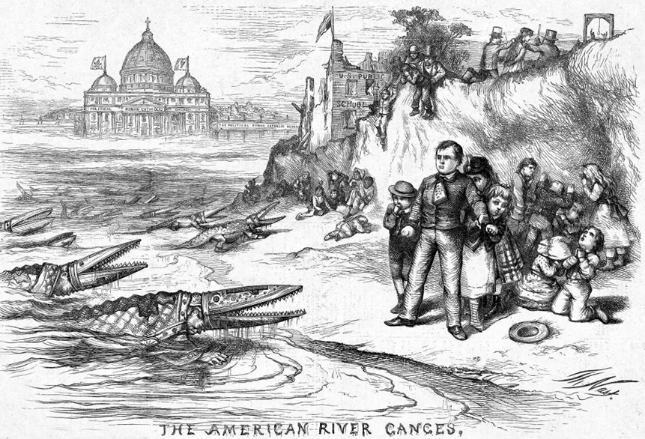
Nativism
An anti-foreign feeling that arose in the 1840's and 1850's in response to the influx of Irish and German Catholics.

Slide 55
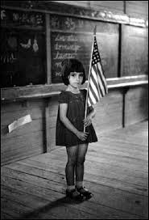
Americanization Movement
This movement took shape in many cities
where volunteers ran programs
to help newcomer learn
English and adopt American
dress and diet.

Slide 56
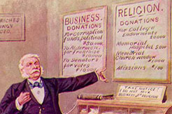
Social Gospel
A 19th-century reform movement based on the belief that Christians have a responsibility to help improve working conditions and alleviate poverty. They believed that by following Bible teachings about charity and justice, people could make society “the Kingdom of God”.

Slide 57
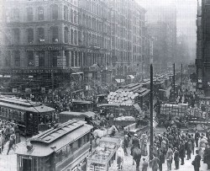
Settlement Houses
A community center providing assistance to residents-particularly immigrants- in slum neighborhoods.

Slide 58
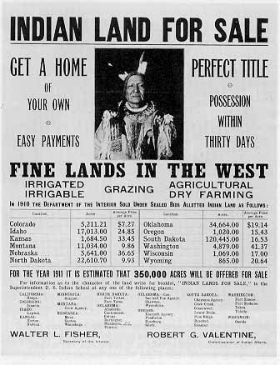
Dawes Act, 1887
It tried to dissolve Indian tribes by redistributing the land. Designed to forestall growing Indian poverty, it resulted in many Indians losing their lands to speculators.

Slide 59
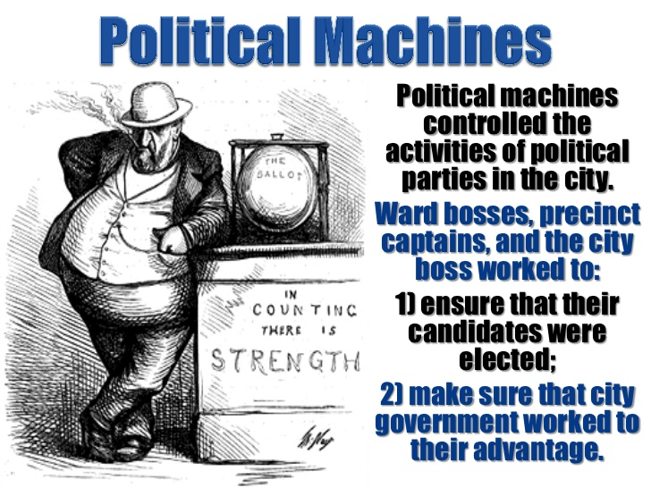

Slide 60
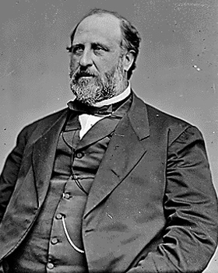
William M. Tweed
Political Boss that was the head of the New York City Political Democratic Machine called Tammany Hall. He ran the machine in the late 1860’s and early 1870’s.
Under his leadership, the “Tweed Ring” stole as much as $200 million dollars from the city.

Slide 61
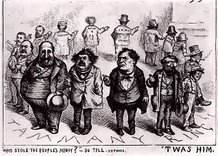
Tammany Hall
Name of New York City’s powerful Democratic political machine in the late 19th Century

Slide 62

W.E.B. DuBois
DuBois believed that black Americans had to demand their social and civil rights or else become permanent victims of racism. Helped found the NAACP. He disagreed with Booker T. Washington's theories.

Slide 63

Booker T. Washington
Washington believed that African Americans had to achieve economic independence before civil rights. In 1881, he founded the first formal school for blacks, the Tuskegee Institute.

Slide 64

Ida B. Wells
African-American woman who campaigned against lynchings in the South
As a black teacher, she helped to block the establishment of segregated schools in Chicago
She was a founder of the NACW – National Association of Colored Women

Slide 65

Populist Party
Also known as the “People’s Party”, this political party was formed in 1891 – 1892 by farmers to give them a bigger voice in government
This party advocated a larger money supply and other economic reforms

Slide 66

William Jennings Bryan
1896 Democratic candidate for President of the U.S., who was backed by both the Democrats and the Populists
Bryan favored using both gold and silver as the nation’s currency
Best known for his “Cross of Gold” speech.
He lost the election.

Slide 67

Cross of Gold Speech, 1896
Given by William Jennings Bryan, he said people must not be "crucified on a cross of gold", referring to the Republican proposal to eliminate silver coinage and adopt a strict gold standard.

Slide 68
Progressive Movement
U.S. History

Slide 69

Causes of Progressivism
Ineffectiveness of government
Poor working conditions
Emergence of Social Gospel
Unequal distribution of wealth
Immigration
Urban poor
Corruption

Slide 70

Muckrakers
Journalists who searched for and publicized real or alleged acts of corruption of public officials, businessmen.

Slide 71

The Jungle
Book written by Muckraker Upton Sinclair in 1906, that portrayed the disgusting conditions of the Chicago meatpacking industry which led the passage of the 1906 Meat Inspection Act.

Slide 72

Jacob Riis
Early 1900's writer who exposed social and political evils in the U.S. Muckraker novel.

Slide 73

Ida Tarbell
Muckraker and journalist who wrote for McClure’s Magazine
She wrote a scathing article that exposed the corruption and cut-throat business practices of John D. Rockefeller and his Standard Oil Company.

Slide 74

Robert LaFollette
Political leader who believed in libertarian reforms, he was a major leader of the Progressive movement from Wisconsin.

Slide 75

Recall
A procedure for removing a public official from office by a vote of the people.

Slide 76

Initiative
A procedure by which a legislative measure can be originated by the people rather than by lawmakers.

Slide 77

Referendum
A procedure by which a proposed legislative measure can be submitted to a vote of the people.

Slide 78

Direct Primary
Election in which citizens themselves vote to select nominees for upcoming elections.

Slide 79

Plessy v. Ferguson, 1896
The Supreme Court ruled against Plessy, saying that segregated facilities for whites and blacks were legal as long as the facilities were of equal quality.

Slide 80

Disenfranchisement
The Mississippi supreme court ruled that poll taxes and literacy tests, which took away blacks' right to vote (a practice known as "disenfranchisement"), were legal.

Slide 81

Jane Addams’ Hull House, 1889
Social reformer who worked to improve the lives of the working class. She founded Hull House in Chicago, the first private social welfare agency in the U.S., to assist the poor, combat juvenile delinquency and help immigrants learn to speak English.

Slide 82

Triangle Shirtwaist Fire, 1911
A fire in New York's Triangle Shirtwaist Company killed 146 people, mostly women. The doors were locked and the windows were too high for them to get to the ground. Highlighted the poor working conditions and led to federal regulations to protect workers.

Slide 83

Spoils System
A practice of winning candidates’ rewarding their supporters with government jobs and appointments

Slide 84

Gerrymandering
The act of dividing a voting area so as to give one political party a majority in that district

Slide 85

Thomas Nast
Newspaper cartoonist who produced satirical cartoons, he invented "Uncle Sam" and came up with the elephant and the donkey for the political parties. He nearly brought down Boss Tweed.

Slide 86

Progressive Party Platform
The platform called for women's suffrage, recall of judicial decisions, easier amendment of the U.S. Constitution, social welfare legislation for women and children, workers' compensation, limited injunctions in strikes, farm relief, revision of banking to assure an elastic currency.

Slide 87

Triple-Threat of Privilege
President Woodrow Wilson called for an all-out-war on what he named the “Triple Wall of Privilege” — the tariff, the banks, and the trusts.

Slide 88

Federal Reserve Act, 1913
Regulated banking to help small banks stay in business. A move away from laissez-faire policies, it was passed by Wilson.

Slide 89

Women’s Christian
Temperance Union
Founded in Chicago in 1873, it promoted the goal of prohibition
Members advanced their cause by entering saloons singing, praying, and encouraging saloon-keepers to quit selling alcohol

Slide 90

Prohibition
The banning of manufacture, sale, and possession of alcoholic beverages

Slide 91

18th Amendment
This addition to the U.S. Constitution, known as “Prohibition”, banned the making, selling, or transporting of alcoholic beverages in the U.S.

Slide 92

National Women’s
Suffrage Association
Group founded in 1890, that worked both the State and National levels to earn women the right to vote.

Slide 93

19th Amendment
This addition to the U.S. Constitution states that the Federal government nor State governments can deny the right to vote on account of sex
Thus this amendment gave the franchise to women starting in 1920

Slide 94
Imperialism &
World War I
U.S. History
Understand the changing role of the U.S. in world affairs through the end of World War I.
Recognize terms and concepts related to U.S. Imperialism
Identify the events that let the U.S. into World War I and the subsequent impact the war had on American society and politics

Slide 95
Imperialism/
Spanish American War
U.S. History

Slide 96

Louisiana Purchase, 1803
The U.S. purchased the land from the Mississippi River to the Rocky Mountains from France for $15 million.
Jefferson was interested in the territory because it was valuable for trade and shipping and provided room to expand.
The Constitution did not give the federal government the power to buy land, so Jefferson used loose construction to justify the purchase.

Slide 97

Seward’s Folly, 1867
An eager expansionist, Seward was the energetic supporter of the Alaskan purchase and negotiator of the deal often called "Seward's Folly" because Alaska was not fit for settlement or farming.

Slide 98

Annexation of Hawaii, 1898
By the late 1800s, U.S. had exclusive use of Pearl Harbor. In July 1898, Congress made Hawaii a U.S. territory, for the use of the islands as naval ports.

Slide 99

Alfred Mahan
As Americans increased business overseas it became necessary to protect those investments. In order to protect those investments America built the "great white fleet" that had been requested by Captain Alfred Thayer Mahan.

Slide 100

Josiah Strong
One of the leading proponents of imperialism was Minister Josiah Strong.
Strong claimed that America as the leading nation in the world it was our destiny to acquire new lands. This idea sounds a lot like Manifest Destiny because it is the same idea.

Slide 101

Yellow Journalism a.k.a. Yellow Press
One of the reasons/causes for the start of the Spanish American War in 1898. This is the use of sensationalized and exaggerated reporting by newspapers to attract readers.

Slide 102

DeLome Letter
A private letter written in February 1898 by Enrique de Lome, who was the Spanish Minister to the U.S.
A Cuban rebel stole the letter from the Havana Post Office and turned it over the New York Word Newspaper which published it.
It criticized President McKinley
calling him “weak”.

Slide 103

U.S.S. Maine
A U.S. warship that mysteriously exploded and sank in the harbor of Havana, Cuba on February 15, 1898 killing 260 men.
This is the main
event that
forced the U.S.
to declare war
with Spain!

Slide 104
Monroe Doctrine, 1823
Declared that Europe should not interfere in the Western Hemisphere and any interference by a European power would be seen as a threat to the U.S.
Mostly just a show of nationalism, the doctrine had no major impact until the late 1800s.

Slide 105

Roosevelt Corollary, 1904
U.S. would act as international policemen. An addition to the Monroe Doctrine.

Slide 106

“Big Stick” Policy
President Theodore Roosevelt’s policy of creating and using, when necessary, a strong military to achieve America’s goals.

Slide 107

Open Door Policy, 1899
Hay sent imperialist nations a note asking them to offer assurance that they would respect the principle of equal trade opportunities, specifically in the China market.

Slide 108

Boxer Rebellion
A 1900 rebellion in which members of a Chinese secret society sought to free their country of Western influence.
The governments of Europe & the U.S. sent in troops to end the rebellion.

Slide 109

Panama Canal
An artificial waterway cut through the Isthmus of Panama to provide a shortcut between the Atlantic and Pacific Oceans. Built by the U.S. it opened in 1914.

Slide 110
World War I
U.S. History

Slide 111

4-MAIN Causes of W.W.I
MILITARISM-The policy of building up armed forces in aggressive preparedness for war.

Slide 112

4-MAIN Causes of W.W.I
ALLIANCES- This is
were two or more nations
form an agreement for a
common objective.
It could be a military
alliance or a trade
alliance.

Slide 113

4-MAIN Causes of W.W.I
IMPERIALISM- The policy of extending a nation’s authority over other countries by economic, political, or military means.

Slide 114

4-MAIN Causes of W.W.I
NATIONALISM- A devotion to the interest and culture of one’s nation. The belief that people should be loyal mainly to their nation-that is to the people with whom they share a culture and history. They share the
same language, food,
religion, dress, ideas,
customs and land.

Slide 115

U.S. - Neutrality to Involvement
May 1915 – U-boats sink the Lusitania
Sept. 1915 – Germany promises not to sink unarmed ships
March 1916 – Germany sinks the Sussex
May 1916 – Germany promises not to sink unarmed ships
Jan. 1917 – Zimmerman note is intercepted
Feb. 1917 – Germany resumes unrestricted submarine warfare
April 1917 – U.S. declares war on Germany

Slide 116

World War I Allies
Great Britain
France
Russia
United States (1917)

Slide 117
World War I Central Powers
Germany
Bulgaria
Ottoman Empire
Austria-Hungary

Slide 118

Propaganda
Britain claimed that the Germans destroyed cathedrals, libraries, and even hospitals. They accused the Germans of leveling towns and killing women and children. Some of these atrocity stories- distributed by the British later
proved to be false. But enough proved to be true. American sympathy
grew for the Allies.

Slide 119

Unrestricted Submarine Warfare
Type of warfare in which the Germans used U-boats to sink any ships heading to Great Britain that were believed to be carrying war contraband.
Germany also stated that I
it would not be possible to
warn crews or passengers
in advance of the attack.

Slide 120

Lusitania
A British passenger ship that was sunk by a German U-boat off the coast of Ireland in May 1915 killing 1,198 people, including 128 Americans. The German’s defended their action on the grounds that the ship carried ammunitions
for the Allies.

Slide 121

Zimmerman Note
A message sent in 1917 by the German foreign minister to the German ambassador in Mexico, proposing a German-Mexican alliance and promising to help Mexico regain Texas,
New Mexico, and Arizona if the
United States entered World War I.

Slide 122

Selective Service Act
A law, enacted in 1917, that required men to register for military service.

Slide 123

Eugene V. Debs
Debs repeatedly ran for president as a socialist, he was imprisoned after he gave a speech protesting WWI in violation of the Sedition Act.

Slide 124

Great Migration
The large-scale movement of African-Americans from the South to Northern cities in the early 20th century.
They did this to escape the “Jim Crow” laws of the South.
Good paying factory
jobs in the North with
less discrimination.

Slide 125

Fourteen Points, 1918
Wilson's idea that he wanted included in the WWI peace treaty, including freedom of the seas and the League of Nations.

Slide 126

League of Nations, 1919
Devised by President Wilson, it comprised of delegates from many countries, the U.S. did not join. It was designed to be run by a council of the five largest countries. It also included a provision for a world court.

Slide 127

Treaty of Versailles
The 1919 treaty that ended World War I.
It contained Article 231, the War Guilt Clause, that blamed the entire war on Germany.

Slide 128

Schenck v. U.S., 1919
United States Supreme Court decision concerning the question of whether the defendant possessed a First Amendment right to free speech against the draft during World War I. During wartime, utterances tolerable in peacetime can be punished.

Slide 129
The 1920’s &
1930’s
U.S. History
Analyze the effects of the changing social, political, and economic conditions of the Roaring Twenties and the Great Depression.
Describe the social and political changes that characterized America during the 1920s
Describe the causes and effects of the Great Depression & The New Deal

Slide 130
The 1920’s
U.S. History

Slide 131

Russian Revolution, 1917
Instituted a Communist government lead by the Bolshevik party under Lenin. Lenin pulled Russia out of WWI.

Slide 132

Communism & Anarchism
Communism-A form of government characterized by a classless society in which the equal distribution of economic goods is achieved by revolutionary or dictatorial means. The one party state owns and controlled all of the factors of production.
Anarchism- The theory that all forms of government interfere unjustly with individual liberty and should be replaced
by the voluntary association
of cooperative groups.

Slide 133

Red Scare
The fear that communists were working to destroy the American way of life during the decade of the 1920’s.

Slide 134

Palmer Raids
The series of raids in the early 1920’s initiated by U.S. Attorney General A. Mitchell Palmer, against suspected radicals and communists.

Slide 135

Sacco and Vanzetti
Sacco and Vanzetti were Italian immigrants charged with murdering a guard and robbing a shoe factory.
Convicted on circumstantial evidence, many believed they had been framed for the crime because of their anarchist and pro-union activities.

Slide 136

Lost Generation
Writer Gertrude Stein told Hemingway, "You are all a lost generation," referring to the many restless young writers who gathered in Paris after WW I.
They thought the U.S. was
materialistic and they
criticized conformity.

Slide 137

1920’s Immigration Quotas
Quotas limiting the number of immigrants were pushed by Americans because of World War I, the Russian Revolution, and the Red Scare. Nativism led to the passage of the Emergency Quota Act of 1921 and the National Origins Act of 1924.

Slide 138

National Origins Act 1924
This law enacted in 1924 set up a formula for establishing immigration quotas in the U.S.: The number of immigrants of a given nationality each year could not exceed 2% of the number of
people of that
nationality living in
the U.S. in 1890.

Slide 139

1920’s Immigration
Groups that were excluded included:
Southern & Eastern Europeans
(Italy, Russia, Yugoslavia, Hungary..)
2. Jews and Catholics
3. Japanese

Slide 140

Ku Klux Klan
A secret organization that used terrorist tactics in an attempt to restore white supremacy in Southern states after the Civil War. This group promoted hatred and discrimination against
specific ethnic and
religious groups.

Slide 141

Impact of Mass Media
Radio
Marketing
Advertising
Jazz
Silent & “talkie” films
“The Jazz Singer”
“Fireside Chats”

Slide 142

1920’s Innovation-
New Consumer Goods
RADIO- This was the most powerful communication medium to emerge in the 1920’s. American’s listened to music, news, sports, westerns, dramas, and soap operas. They also heard
commercials for a wide
variety of consumer products.

Slide 143

1920’s Innovation-
New Consumer Goods
AUTOMOBILE-The automobile literally changed the American landscape in the 1920’s. It led to paved roads, gasoline stations, repair shops, public garages, motels, shopping centers,
car dealerships, and traffic
signals. It created drive-ins,
family vacations, & urban
sprawl.

Slide 144

1920’s Innovation-
New Consumer Goods
ELECTRIC APPLIANCES- The 1920’s saw an enormous increase in the number and kinds of goods available. Many small electric appliances such as
vacuum cleaners, refrigerators,
and toasters flooded the market.
It made the lives of housewives
easier, & freed them to do more
community & leisure activities.

Slide 145

New Marketing Techniques
Advertising
Mail order catalogs
Consumerism

Slide 146

1920’s Prohibition
Reformers believed that liquor led to crime, wife and child abuse, accidents on the job, and other serious social problems. Other Americans did not believe alcohol was sinful or dangerous in moderation. They believed that drinking
was a personal decision and
resisted any group including
the government telling them
how to live.

Slide 147

Bootleggers, Gangsters, Speakeasy Bars
Drinkers went underground to hidden saloons & nightclubs called speakeasies were liquor was sold. Most of this liquor was made by bootleggers and controlled by gangsters like Chicago’s Al Capone.

Slide 148

Flappers, 1920’s
Women started wearing short skirts and bobbed hair, and had more sexual freedom. They began to abandon traditional female roles and take jobs usually reserved for men.

Slide 149

Harlem Renaissance
A flowering of African-American artistic creativity during the 1920’s centered in the Harlem community of New York City.

Slide 150

Langston Hughes
Hughes was a gifted writer who wrote humorous poems, stories, essays and poetry. Harlem was a center for black writers, musicians, and intellectuals.

Slide 151

Jazz Age
American music form developed by African-Americans, based on improvisation and blending blues, ragtime, and European-based popular music. The music was born in New Orleans in the early
20th century and quickly spread
to places like NYC were it was
made popular by Louis
Armstrong, Duke Ellington, &
Cab Calloway.

Slide 152

Marcus Garvey
A Jamaican immigrant who believed that African-Americans should build a separate
society. He founded the UNIA. He also
preached that African-Americans needed an
independent nation. That they should return
to Africa and build one. He
was convicted of mail fraud
and deported back to Jamaica.

Slide 153

Teapot Dome Scandal 1921
President Warren G. Harding’s Secretary of the Interior Albert B. Fall’s secret leasing of oil-rich public lands in Teapot Dome, Wyoming to private companies in return for money and land. He got caught and was sent to jail.

Slide 154

Fundamentalism
Movement or attitude stressing strict and literal adherence to a set of basic principles.

Slide 155

Scopes Trial, 1925
Prosecution of school teacher, John Scopes, for violation of a Tennessee law forbidding public schools from teaching about evolution. Scopes was convicted and fined $100, but the trial started a shift of public opinion away from Fundamentalism.

Slide 156

Protective Tariffs
A tax on imported goods that is intended to protect a nation’s businesses from foreign competition.

Slide 157

Charles Lindbergh
In 1927 Charles Lindbergh makes the first solo transatlantic flight in his plane called the “Spirit of St. Louis”

Slide 158

Stock Market Crash, 1929
On October 24, 1929, panic selling occurred as investors realized the stock boom had been an over inflated bubble. Margin investors were being decimated as every stock holder tried to liquidate. Millionaire margin investors became bankrupt instantly, as the stock market crashed on October 28 and 29.

Slide 159
The 1930’s
Great Depression
U.S. History

Slide 160

Buying on Margin
In the 1920’s, many middle class people felt that they could make a fortune from the stock market. Many bought stocks on credit (margin). They would borrow cash from a broker.

Slide 161

Causes of Great Depression
Much debt, stock prices spiraling up, over-production and under-consuming, the stock market crashed. Germany's default on reparations caused European bank failures, which spread to the U.S.

Slide 162

Installment Plan
During the 1920’s companies wanted to lure consumers to purchase goods. So they came up with easy credit. The Installment Plan as it was called, enabled people to buy goods over an extended period, without having to put down much money at the time of the
purchase.

Slide 163

President Franklin D. Roosevelt
Born into a wealthy New York family, FDR entered politics in 1910. In 1928 he was elected the democratic governor of New York. FDR suffered from polio and was paralyzed. In 1933 he ran for president of the United States and won. He went on to be elected three more times leading the U.S. through the Great Depression and World War II.

Slide 164

New Deal
President Franklin D. Roosevelt’s program to alleviate the problems of the Great Depression, focusing on relief for the needy, economic recovery, and financial reform.

Slide 165

Hundred Days
Upon taking office, FDR & the federal government launched into a period of intense activity, known as the “Hundred Days”. Lasting from March 9 to June 16, 1933 it was during this period that Congress passed more than 15 major pieces of New Deal legislation. These laws expanded the federal governments roll in the nation’s economy.

Slide 166

Bank Failures
During the first 10 months of 1930, 744 banks failed. In all, 9,000 banks failed during the decade of the 1930s. By 1933, depositors saw $140 billion disappear through bank failures.

Slide 167

Bank Holiday
On March 5, 1933, one day after taking office, FDR declared a bank holiday and closed all banks to prevent further withdrawals. Then he persuaded Congress to pass the Emergency Banking Relief Act which ordered the inspection of the nation’s banks. Those that were sound could reopen at once
and those that were
insolvent-would remain closed.

Slide 168

New Deal Agencies
Federal Deposit Insurance Corporation (FDIC)
Securities and Exchange Commission (SEC)
Works Progress Administration (WPA)
Public Works Administration (PWA)
Civilian Conservation Corps (CCC)
Agricultural Adjustment Act (AAA)
Tennessee Valley Authority (TVA)

Slide 169

Social Security Act
A law enacted in 1935 to provide aid to retirees, the unemployed, people with disabilities, and dependent mother’s and children.

Slide 170

Fireside Chats
President FDR wanted to boost confidence and enlighten Americans on the programs of the New Deal. He did this through a series of radio talks called the “fireside chats”. These talks made Americans feel
as if the president was
talking directly to them.

Slide 171

Bonus Army, 1932
Facing the financial crisis of the Depression, WW I veterans asked Congress to pay their retirement bonuses early. Congress considered a bill, but it was not approved. Angry veterans marched on Washington, D.C., and Hoover called in the army.

Slide 172

Black Cabinet
Group of African-American leaders who served as unofficial advisers to President Franklin D. Roosevelt.

Slide 173

1934 Indian Reorganization Act
This law gave Native Americans greater control over their destiny. It mandated changes in three areas-economic, cultural, and political.
1.Economic- There land would no longer be broken up into individual farms, but would belong to the entire tribe as a whole.
2.Cutural- The number of boarding schools would be cut back, and children could attend day schools on the reservations.
3.Political- Tribes could elect tribal councils to govern their reservations.

Slide 174

Indian New Deal
1930’s legislation that gave Indians greater control over their affairs and provided funding for schools and hospitals.

Slide 175

Dust Bowl, 1930s
A series of catastrophic dust storms caused major ecological and agricultural damage to American prairie lands in the 1930s, caused by decades of inappropriate farming techniques.
Hardest hit: Oklahoma,
Texas, Kansas, New Mexico.
Many people left the area for
California to start a new life.

Slide 176

Long Term Effects of New Deal Programs
Expansion of the role of federal government
Government responsibility for the welfare of its citizens
Expanding government role in the economy
Deficit spending

